Slide 1

Android Studio
official integrated development environment for Google's Android operating system, built on JetBrains' IntelliJ IDEA software and designed specifically for Android development.

Slide 2
What are the software requirements?
Why to learn Android studio?
Windows
ram: 8GB recommended
4GB disk space recommended
mac
ram: 8GB recommended
4GB disk space recommended

Slide 3
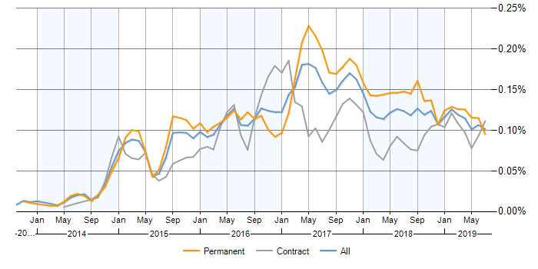

Slide 4
How to use?
Java or Kotlin
Backend(.java file)
Xml
Frontend(.xml file)

Slide 5
Components of any application
Activity
Services
Content provider
Broadcast receivers

Slide 6
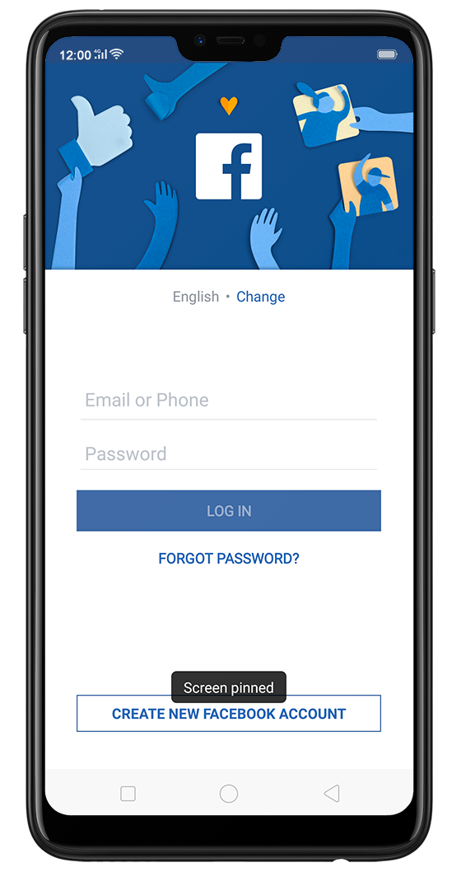
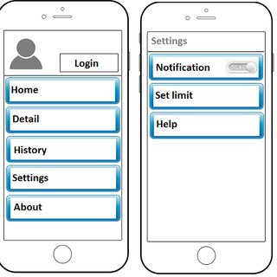
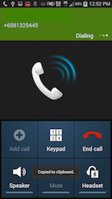
Activity

Slide 7

.java files
.class file
Java compiler
Xml files
Image files
(android asset packaging unit)
aap
.apk

Slide 8
Project Demonstration

Slide 9
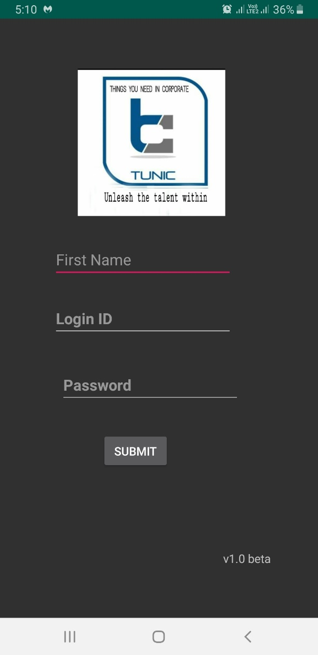
Login page

Slide 10
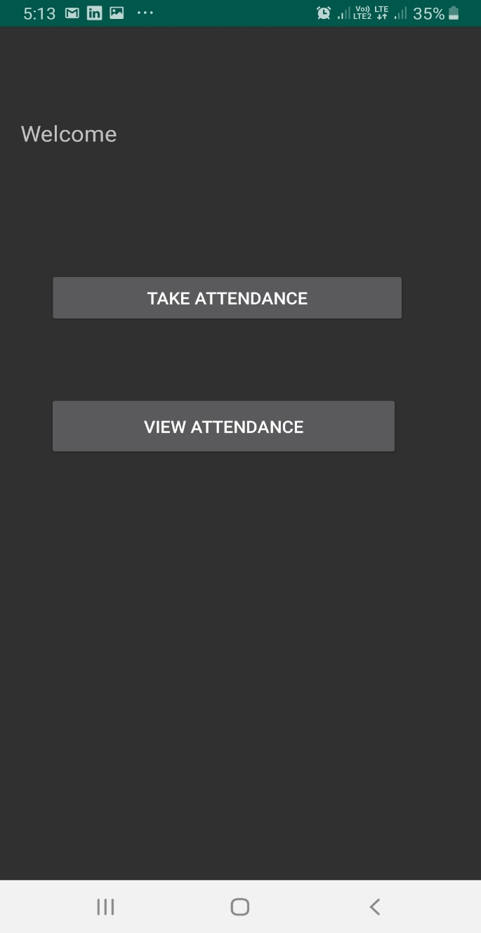
Feature page

Slide 11
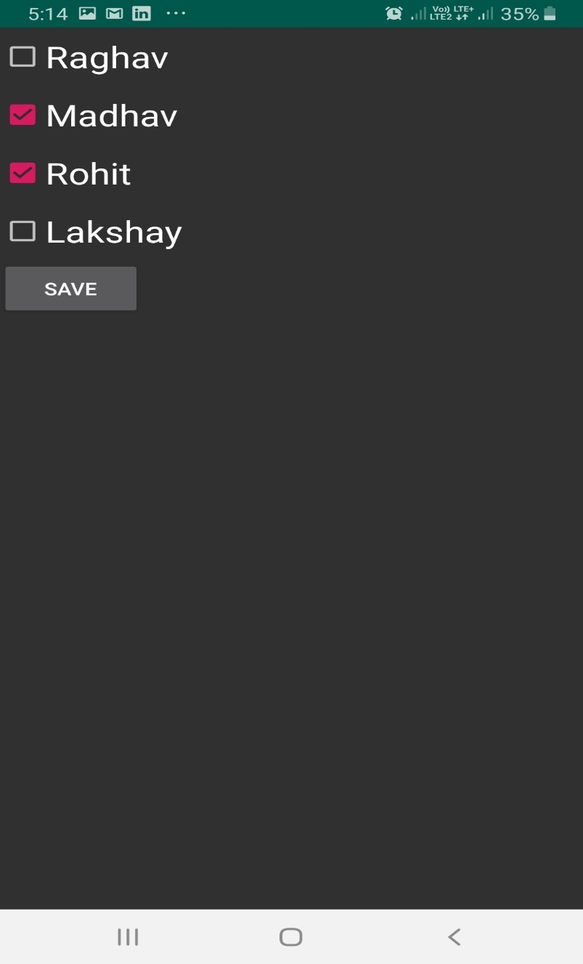
Attendance page

Slide 12
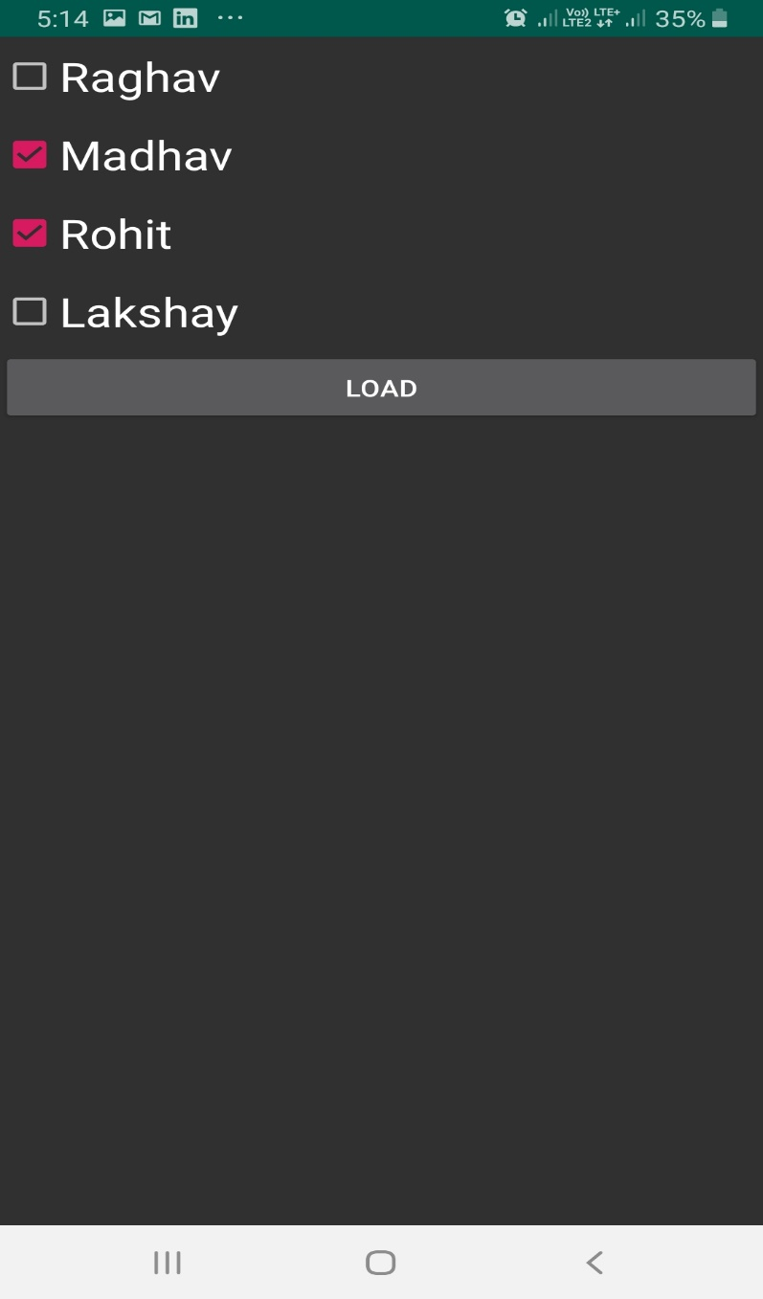
View attendance page

Slide 13
Database- Sqlite
Specially designed for applications for android
Works on the same principle of Sql.
Can handle small data

Slide 14
Thank you , any queries?

